Slide 1




Multi-Intent Classification in Chatbots
Project Guide
Dr. E. Sivasankar
Project Team Members
106118058 Asif
106118085 Sampurn
106118116 Supria

Slide 2
Introduction
Why Chatbot for the institute?
Helps an organization to reach out to its daily visitors of official website
Solve issues at the earliest without any hassle
Our main aim is to create one Chatbot for our official college website.
Frameworks:
RASA and IBM Watson chatbot frameworks
Concepts:
Multi-Intent Classification

Slide 3
Introduction
Base Algorithms:
SVM and CRF. BiLSTM, BiGRU, and BERT.
Datasets:
Initially, we will be using datasets of ATIS (Airline Travel Information System), SNIPS (weather, playing a song, book a restaurant, asking for a movie schedule), and AskUbuntu (Chatbot, Web Applications).
Performance measures:
Accuracy and Macro F1-score for evaluation

Slide 4
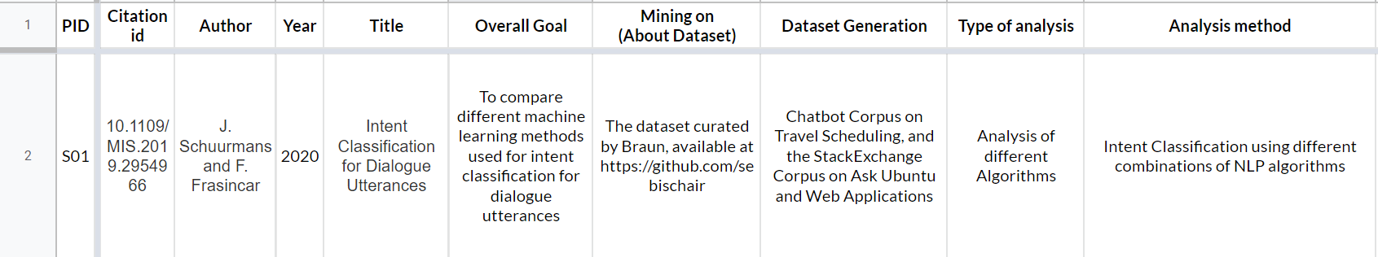
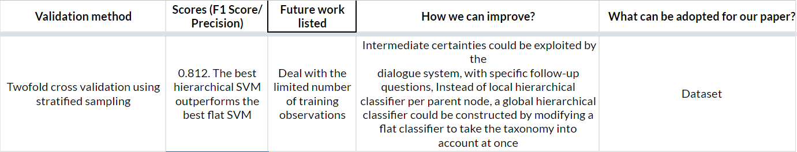
Literature Survey:

Slide 5
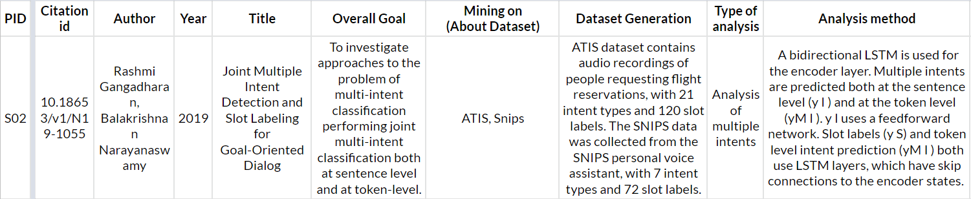
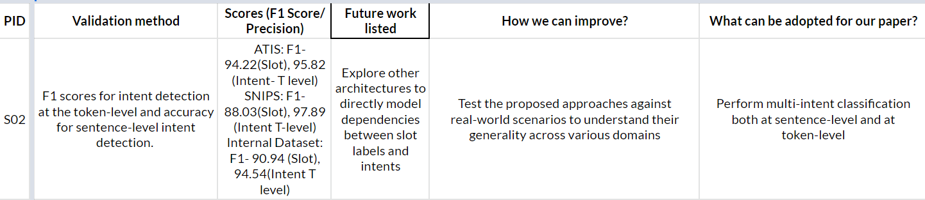
Literature Survey

Slide 6
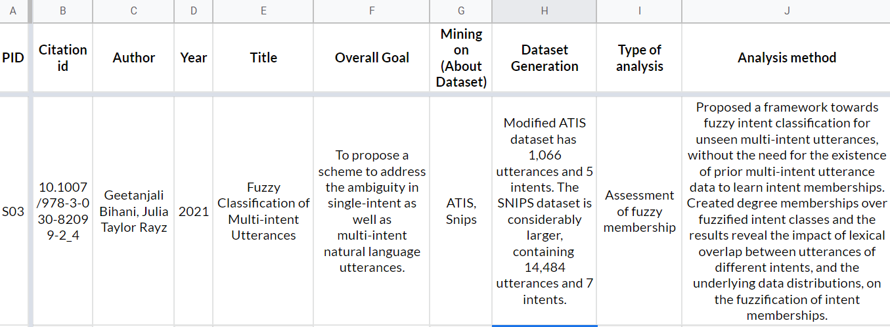
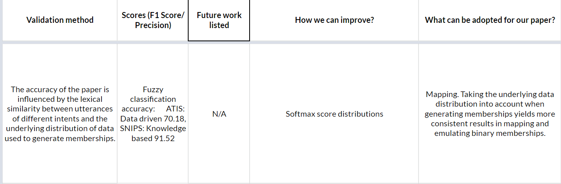
Literature Survey

Slide 7
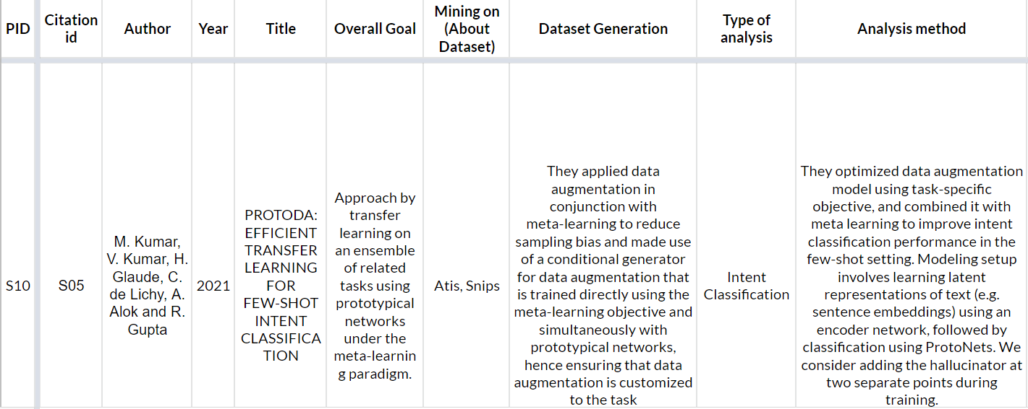
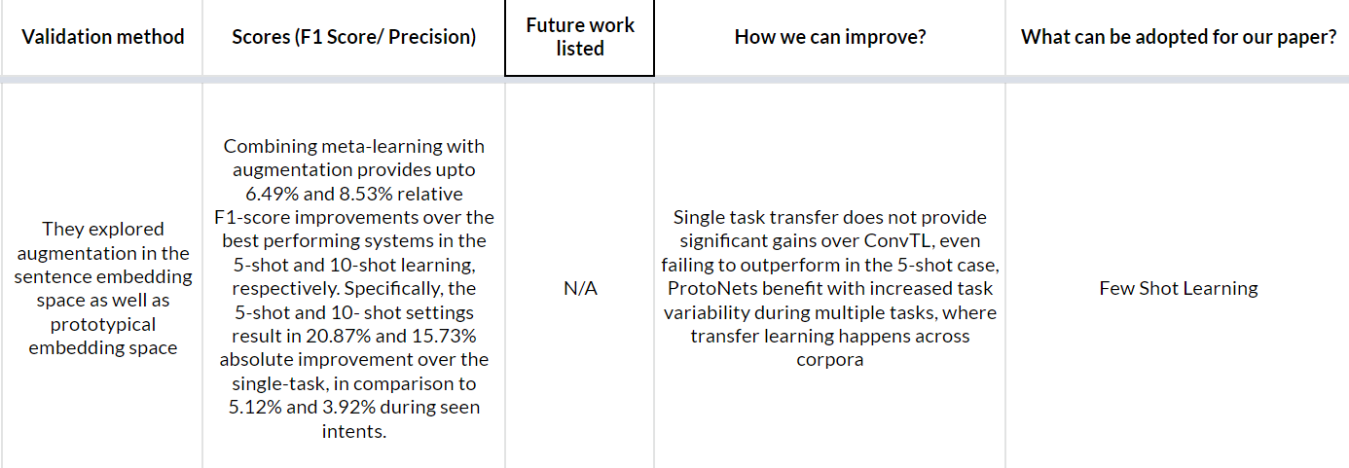
Literature Survey

Slide 8
Issues in solving the problem and Gaps from literature
In all the existing works, the authors have used AI and NLP algorithms only. So, any new type of query will not be answered.
We have to deal with the limited number of training observations.
A global hierarchical classifier could be constructed
More architectures have to be explored to directly model dependencies between slot labels and intents
Issues are there for multilingual sentence embeddings. Some languages are performing extremely well and some really poor.
We will be using Zero shot learning or Few-shot learning for model training and validation.

Slide 9
Problem Statement
Generalized Learning Methods for Intent Classification using Zero Shot Learning and Few Shot Learning
Chatbot for institute using Multi Intent Classification
It will be designed for our institute.
Since Zero shot learning will be used, the bot can be used for multiple purposes.

Slide 10
Objectives
Make a multi-purpose chatbot which will respond to all types of possible queries
Initially, we are implementing it for our college’s website , but it can be further extended.
Multi-intent classification will be used. So, in one query itself user can get multiple tasks done.
Zero-shot learning will ensure that our Chatbot can be used for multiple purposes and keeps on expanding its features.

Slide 11
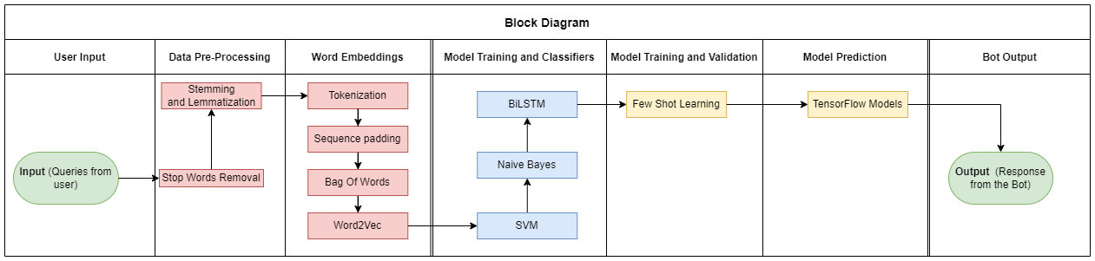
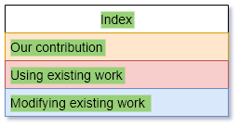
Block Diagram

Slide 12
Proposed System Data Pre-processing
Stop words removal
Removing the words that occur commonly across the input text in the corpus.
Stemming and Lemmatization
Reducing a word to its word stem that affixes to suffixes and prefixes or to the roots of words known as a lemma.

Slide 13
Proposed System Word Embedding
Tokenization
Splitting a phrase, sentence, paragraph, or an entire text document into smaller units, such as individual words or terms. Each of these smaller units will be called tokens.
Sequence padding
Ensuring that all sequences in a list have the same length
Bag Of Words
Simplifying representation used in natural language processing and information retrieval (IR). In this model, a text (such as a sentence or a document) is represented as the bag (multiset) of its words, disregarding grammar and even word order but keeping multiplicity.
Word2Vec or FastText or GloVe
Two-layer neural net that processes text by “vectorizing” words. Its input is a text corpus and its output is a set of vectors: feature vectors that represent words in that corpus.

Slide 14
Proposed System Model Training and Classification
SVM
Support vector machines (SVMs) will be used for doing both classification and regression.
Naive Bayes
“probabilistic classifiers” coupled with kernel density estimation, will be used to achieve higher accuracy levels in our project
LSTM or Bi-LSTM
Long short-term memory (LSTM) will be used for classifying, processing and making predictions based on time series data, since there can be lags of unknown duration between important events in a time series.

Slide 15
Proposed System Model Training and Validation
Zero shot learning
The bot will observe samples from classes that were not observed during training and needs to predict the class they belong to.
Few-shot learning
Will be used for making predictions based on a limited number of samples. The goal of using few-shot learning is not to let the model recognize the queries in the training set and then generalize to the test set, instead, the goal is to learn.

Slide 16
Proposed System Model Prediction
TensorFlow and Keras models
Will be used for making prediction in our single-variable linear regression model.

Slide 17
Platforms and Tools
OPERATING SYSTEM:
Windows 11
LANGUAGES:
Python, PHP, RASA, HTML
DATABASES:
MySQL
Tools:
Data Processing Tools of Python

Slide 18
References
J. Schuurmans and F. Frasincar, (2020) "Intent Classification for Dialogue Utterances," in IEEE Intelligent Systems, vol. 35, no. 1, pp. 82- 88, https://doi.org/10.1109/MIS.2019.2954966 .
T. -Y. Chen, Y. -C. Chiu, N. Bi and R. T. -H. Tsai, (2021) "Multi-Modal Chatbot in Intelligent Manufacturing," in IEEE Access, vol. 9, pp. 82118- 82129 https://doi.org/10.1109/ACCESS.2021.3083518
A. Benayas, R. Hashempour, D. Rumble, S. Jameel and R. C. De Amorim, (2021) "Unified Transformer Multi-Task Learning for Intent Classification With Entity Recognition," in IEEE Access, vol. 9, pp. 147306-147314, https://doi.org/10.1109/ACCESS.2021.3124268
T. -Y. Chen, Y. -C. Chiu, N. Bi and R. T. -H. Tsai, (2021) "Multi-Modal Chatbot in Intelligent Manufacturing," in IEEE Access, vol. 9, pp. 82118-82129, 2021, https://doi.org/10.1109/ACCESS.2021.3083518
A. Benayas, R. Hashempour, D. Rumble, S. Jameel and R. C. De Amorim, (2021) "Unified Transformer Multi-Task Learning for Intent Classification With Entity Recognition," in IEEE Access, vol. 9, pp. 147306-147314, 2021, https://doi.org/10.1109/ACCESS.2021.3124268
M. Kumar, V. Kumar, H. Glaude, C. de Lichy, A. Alok and R. Gupta(2021) "PROTODA: EFFICIENT TRANSFER LEARNING FOR FEW-SHOT INTENT CLASSIFICATION" in IEEE https://doi.org/10.1109/SLT48900.2021
Zixian Feng, Caihai Zhu, Weihan, Zhang, Zhigang Chen, Wanxiang Che, Minlie Huang, Linlin Li (2021), "An Evaluation of Chinese Human-Computer Dialogue Technology" MIT Press Direct Data Intelligence (2021) 3 (2): 274–286, https://doi.org/10.1162/dint_a_00090
Tulika Saha, Dhawal Gupta, Sriparna Saha, and Pushpak Bhattacharyya (2021) “A Unified Dialogue Management Strategy for Multi-intent Dialogue Conversations in Multiple Languages” in ACM Trans. Asian Low-Resour. Lang. Inf. Process, Vol - 20, 6, Article 99 (November 2021), 22 pages. https://doi.org/10.1145/3461763

Slide 19
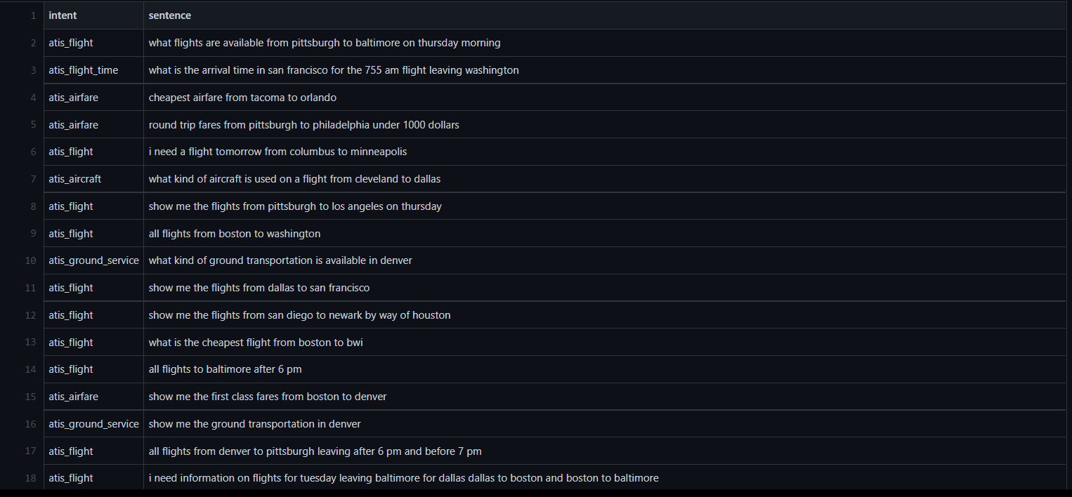
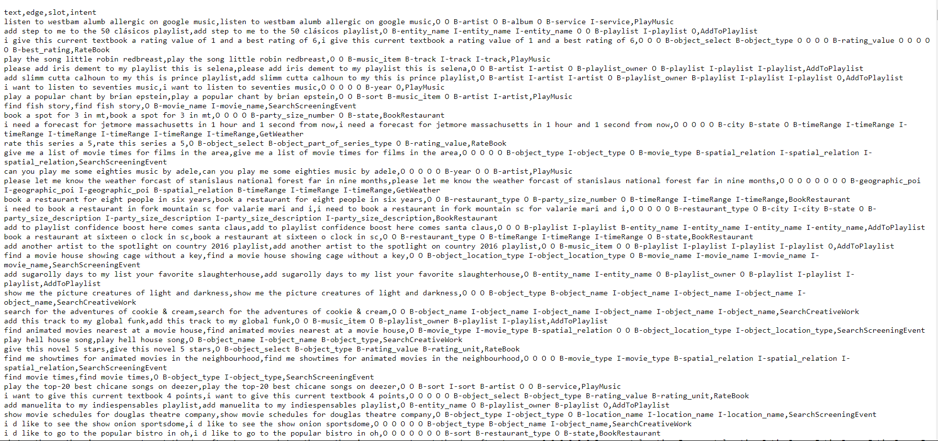
Dataset – link and sample dataset format
https://github.com/ChatBot-FYP-NITT/MIC_Project/blob/2309ffefe2f68269474d5f86ea585e539d614ae2/snips_intents_train.csv
Data Sample:
https://github.com/ChatBot-FYP-NITT/MIC_Project/blob/2309ffefe2f68269474d5f86ea585e539d614ae2/atis_intents_train.csv
Data Sample:

